Slide 1
Assistant code evaluator
Infrastructure

Slide 2
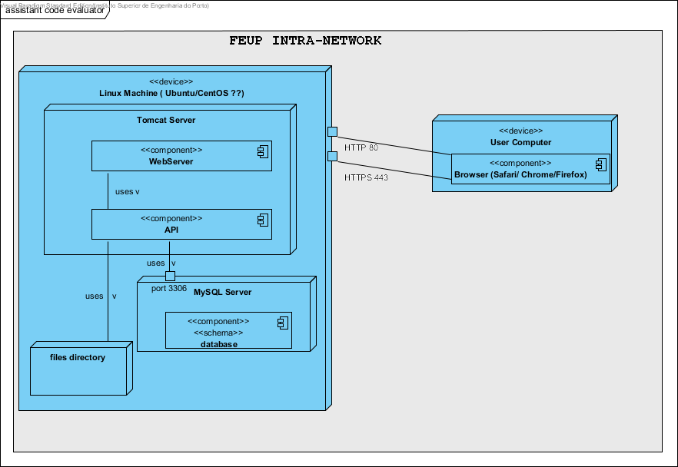
Architecture – deployment diagram

Slide 3
Architecture Characteristics
First, only one server is needed with a Linux OS, maybe Ubuntu or CentOS. CentOS is, according some online users, is the most recommended. (to be decided with all team members)
Second, the web-server should be Tomcat. (to be decided with all team members)
Third, we should use HTTPS, for security reasons.
Fourth, the application should be developed mainly for Safari, Chrome and Firefox browsers, since they are the most used.
Fifth, the student’s exam responses should be stored in directories.
Sixth, the database is only accessed by the web application.
Seventh, the web application can only be accessed inside FEUP network, therefore we need to connect to the VPN !!!

Slide 4
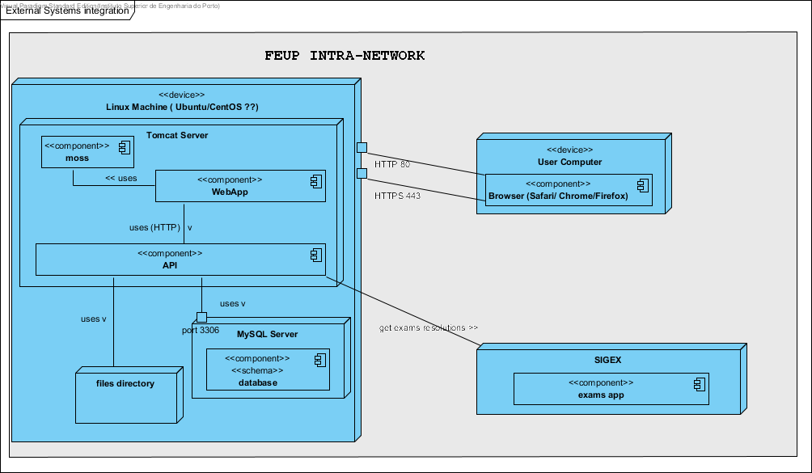
Architecture – external systems

Slide 5
Architecture – external systems characteristics
The API can interact with SIGEX system to submit the files automatically.
To check for code similarities, the API can use the MOSS software (https://github.com/nordicway/moji).

Slide 6
Questions
The server can have storage problems in the future… what strategies can we use?
Delete files automatically (time-to-time);
Delete files manually (the user should be notified whenever there’s low storage space);
Regarding security what’s the approach that we must use? Should we care a lot with security??

Slide 7
Tasks
Decide OS, web-server technology.
Decide security.
See how MOSS works. (+-optional)
See how SIGEX works. (optional)

